Slide 1
Decision Making for Games

Slide 2
Overview
Introduction
Finite State Machines
Decision Trees
Behaviour Trees
Planning Systems
References

Slide 3
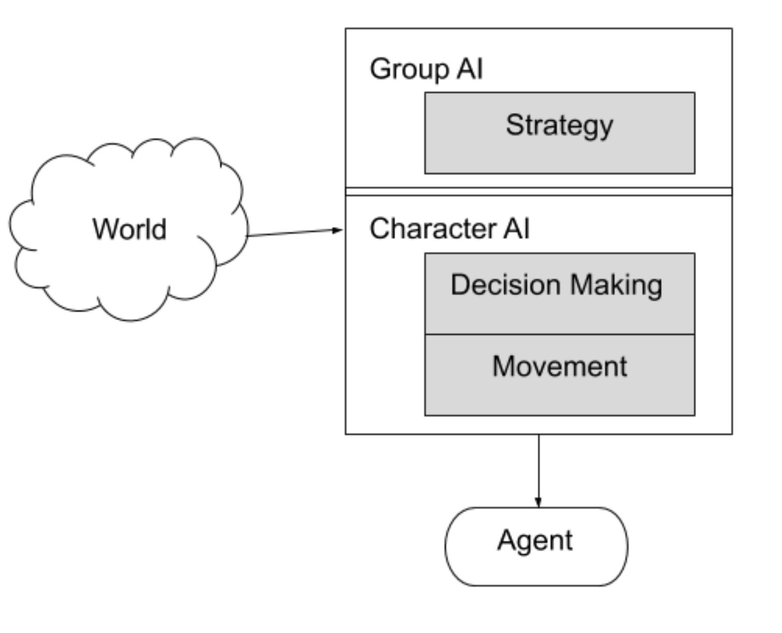
GameAI: the Model

Slide 4
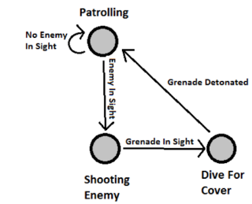
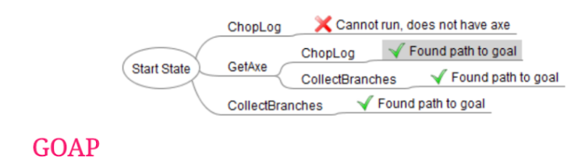
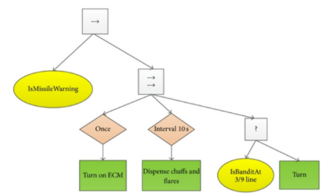
Decision Making
FSM
GOAP
Input: World Knowledge
Output: Action
Important rule: Decision Making should NOT execute every frame!
Main algorithms:
Finite State Machines
Behaviour Trees
Goal Oriented Action Planning
BT

Slide 5
Overview
Introduction
Finite State Machines
Code(delegates)
Visual Scripting
Decision Trees
Behaviour Trees
Planning Systems
References

Slide 6
C# Coroutine Example
IEnumerator<int> fibonacci()
{
int a = 0; // Output:
int b = 1; // 0,1,1,2,3,5,8,13,21,34...
yield return a;
while (true)
{
yield return b;
int c = b;
b = a + b;
a = c;
}
}
void Start()
{
IEnumerator<int> f = fibonacci();
for(int i = 0; i < 10; i++)
{
f.MoveNext();
Debug.Log(f.Current);
}
}

Slide 7
C # coroutines
Example:
using UnityEngine;
using System.Collections;
public class WaitForSecondsExample : MonoBehaviour {
void Start() {
StartCoroutine(“Example”);
}
IEnumerator Example() {
Debug.Log(Time.time);
yield return new WaitForSeconds(5);
Debug.Log(Time.time);
}
}
StartCoroutine: type of asynchronous "functions"
IEnumerator: returning type
yield: stops execution until something happens
yield return null: until next frame
yield break: finish the coroutine

Slide 8
C# delegates
Assigning functions to variables
Example:
public class DelegateScript : MonoBehaviour {
delegate void MyDelegate(int num);
MyDelegate myDelegate;
void Start () {
myDelegate = PrintNum;
myDelegate(50);
myDelegate = DoubleNum;
myDelegate(50);
}
void PrintNum(int num) {
Debug.Log(num);
}
void DoubleNum(int num) {
Debug.Log(num * 2);
}
}

Slide 9
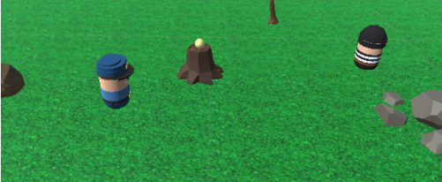
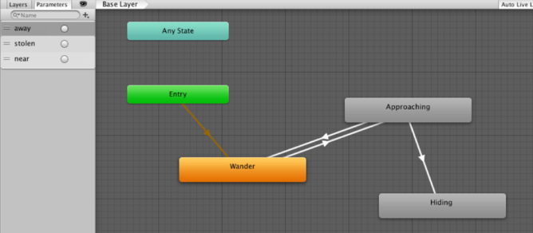
FSMs IN Unity
Scene(link unity package) :
Task : FSM for the robber
https://learn.unity.com/tutorial/finite-state-machines-1#

Slide 10
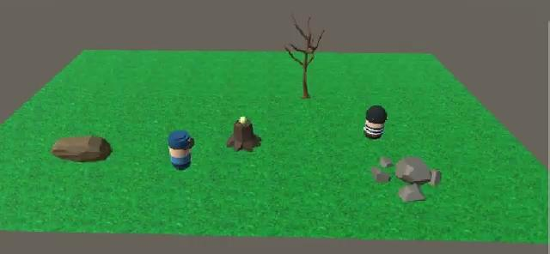

Slide 11
FSM with coroutines & delegate
Code template:
public class FSM : MonoBehaviour
{
...
private WaitForSeconds wait = new WaitForSeconds(0.05f); // 1 / 20
delegate IEnumerator State();
private State state;
IEnumerator Start()
{
...
state = Wander;
while (enabled)
yield return StartCoroutine(state());
}
IEnumerator Wander()
{
Debug.Log("Wander state");
...
}
}

Slide 12
TODO
Coroutine that executes 20 times per second and goes forever.
Explicit every state change with Debub.Log.
First behaviour is slowly wander.
When the cop walks away from the treasure he has to approach quickly to steal it.
If the cop comes back he returns to wander slowly and so on.
If the robbery is successful (the treasure must disappear), he begins to permanently hide in the obstacle closest.
solution: view* / download
Homework
Watch the videos (5mn): Killzone 2 Review about AI & F.E.A.R. 2 - A.I.

Slide 13
Overview
Introduction
Finite State Machines
Code(delegates)
Visual Scripting
Decision Trees
Behaviour Trees
Planning Systems
References

Slide 14
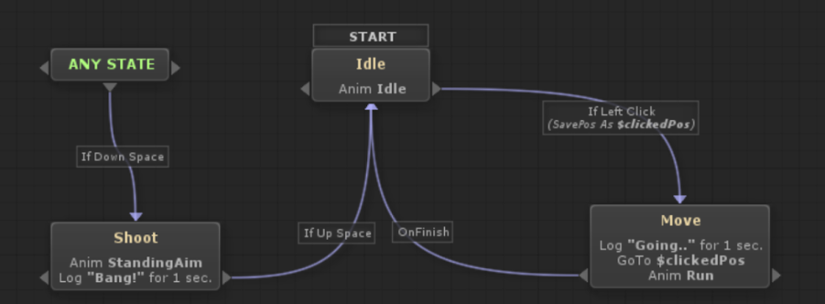
Visual Scripting
Visual editors helps handling complex behaviours
Separates coders from game designers
Many options:
CryEngine's flowgraph
Unreal Kismet / Blueprint
Unity PlayMaker

Slide 15
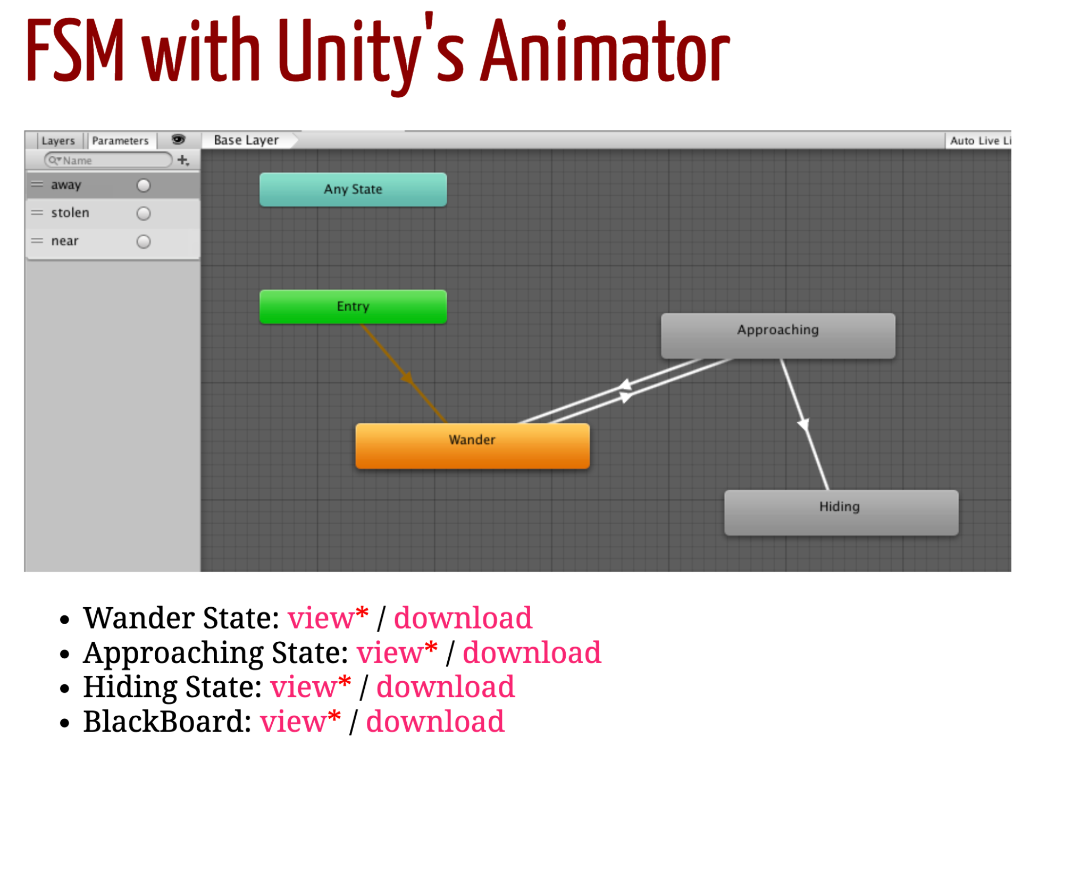
FSM with Unity’s Animator
Wander State: view* / download
Approaching State: view* / download
Hiding State: view* / download
BlackBoard: view* / download
https://github.com/EjbejaranosAI/AI4VJ/tree/main/Lecture%20material/T3

Slide 16
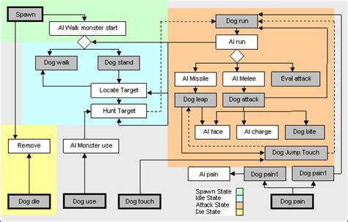
Hierarchical FSM
Complex Behaviours:

Slide 17
Overview
Introduction
Finite State Machines
Decision Trees
Behaviour Trees
Planning Systems
References

Slide 18
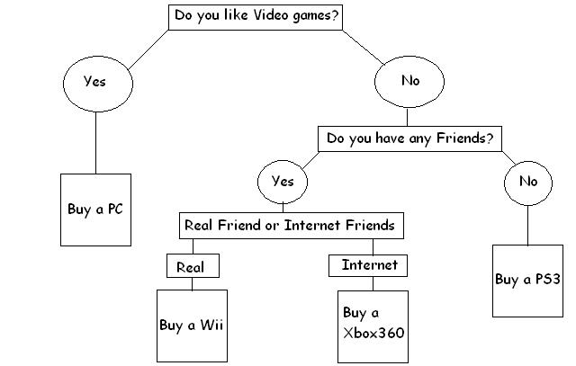
What Video Game System Shoulds I own
A very simple yet accurate guide on what Video Game System is right for you
source

Slide 19
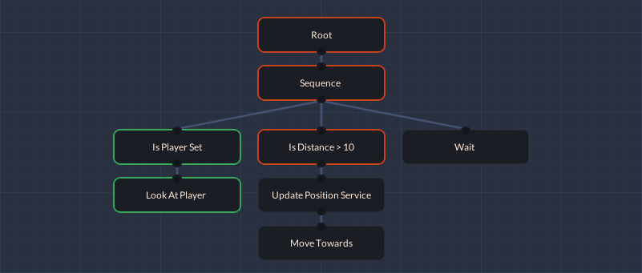
A decision tree is a tool for making decisions by breaking them into a series of questions, where each answer leads to a new question or final outcome. It works by starting at a main question (root), and based on the answer, it follows a branch to the next step until it reaches a decision (leaf).

Slide 20
FSM vs DTs
FSM: States (with Actions) & Transitions (with conditions)
DTs: Conditions (tree nodes) & Actions (leafs).
It has no notion of state; we have to go through the whole tree every time we run it.
How could we use decision trees in games?
NPCs Dialogs
Bosses that switch state every % HP
Bosses that makes different abilities depending on climates conditions
Decision trees can be generated automatically. We will see this in the topic of machine learning.

Slide 21
Overview
Introduction
Finite State Machines
Decision Trees
Behaviour Trees
Design
Behaviour Bricks
Planning Systems
References

Slide 22
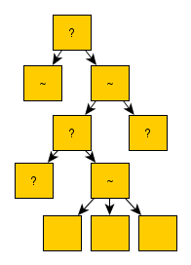
Behaviour Trees
Sort of visual programming for AI behaviour (Isla, 2005)
Reusability & modularity
Major engines: unreal, cryengine, unity
Behavior Tree combine both:
Decision trees: execute all at once
State machines: current state implicit
the execution stays in one of the nodes
Designing Trees is a hard task! Reference: Behavior trees for AI: How they work

Slide 23
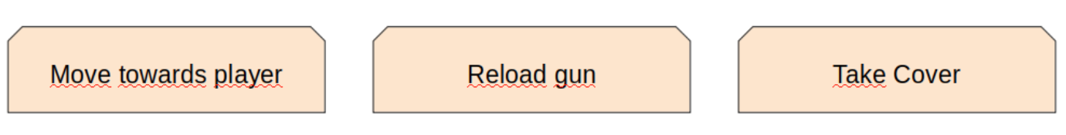
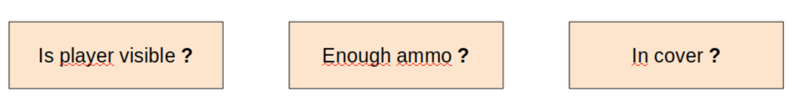
Node Types I
Actions
All should return Running, Success or Failure
They can take a while!
Most of the time they will be leaf nodes
Conditions
All should return True or False
Conditions normally refer to the blackboard for questioning the world state

Slide 24
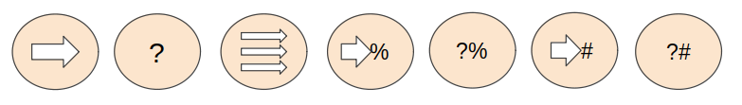
Node Types II
Composites
All should return True or False
They iterate all childs from left to right in a specific fashion:
Sequence (AND): A node that executes all its children until one fails
Selector (OR): A node that executes all its children until one succeeds
Parallel (Concurrent AND): Execute all its children at the same time until one fails
Random Sequence or Selector (with %?): Same as sequence or selector but randomly
Priority Sequence or Selector (with %#): Same as sequence or selector but follow a mutable priority

Slide 25
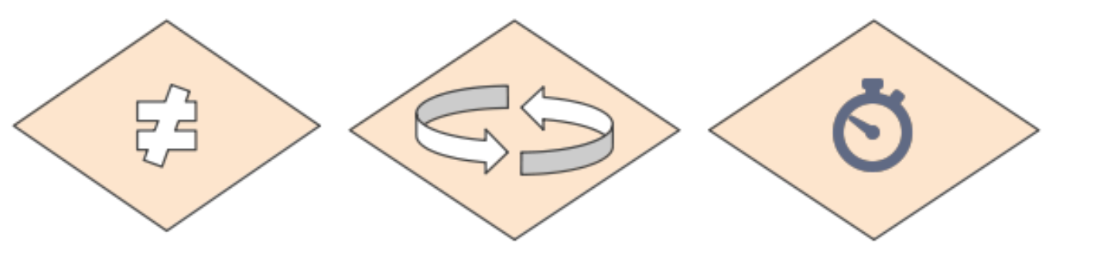
Node Types III
Decorators
All should return Running, Success or Failure
Add enormous flexibility and power to the tree execution flow
They modify one specific child in some fashion:
Inverter (NOT): invert the result of the child node
Repeater (until fail, N or infinite): basically repeat the child node until fail or N times
Wait until (seconds, condition, etc.): basically a generic delay

Slide 26
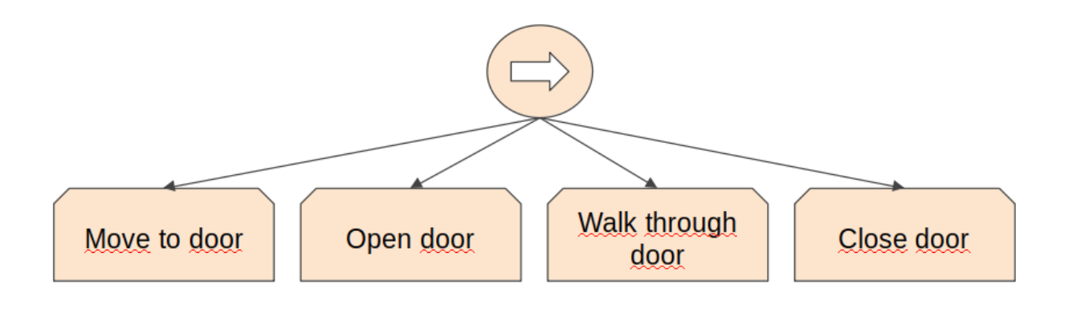
Example I
Behavior trees for AI: How they work

Slide 27
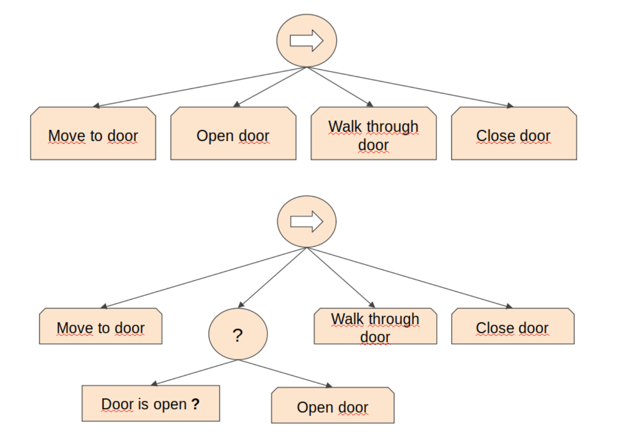
Example I
Behavior trees for AI: How they work

Slide 28
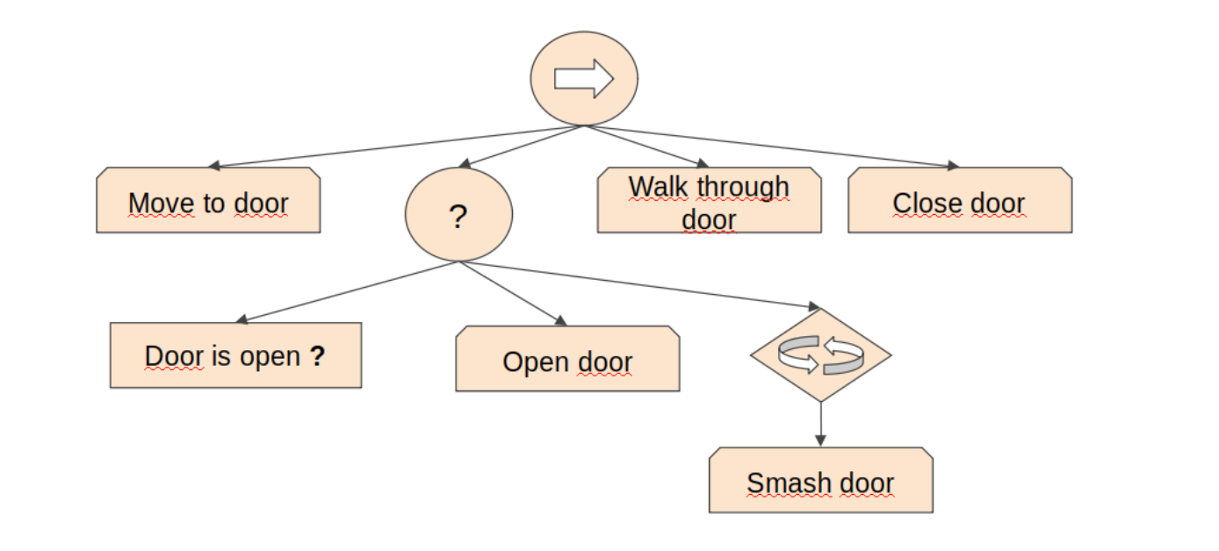
Example I
Behavior trees for AI: How they work

Slide 29
Exercise
What about the Robber?
Template link for design BTs
Behavior trees for AI: How they work

Slide 30
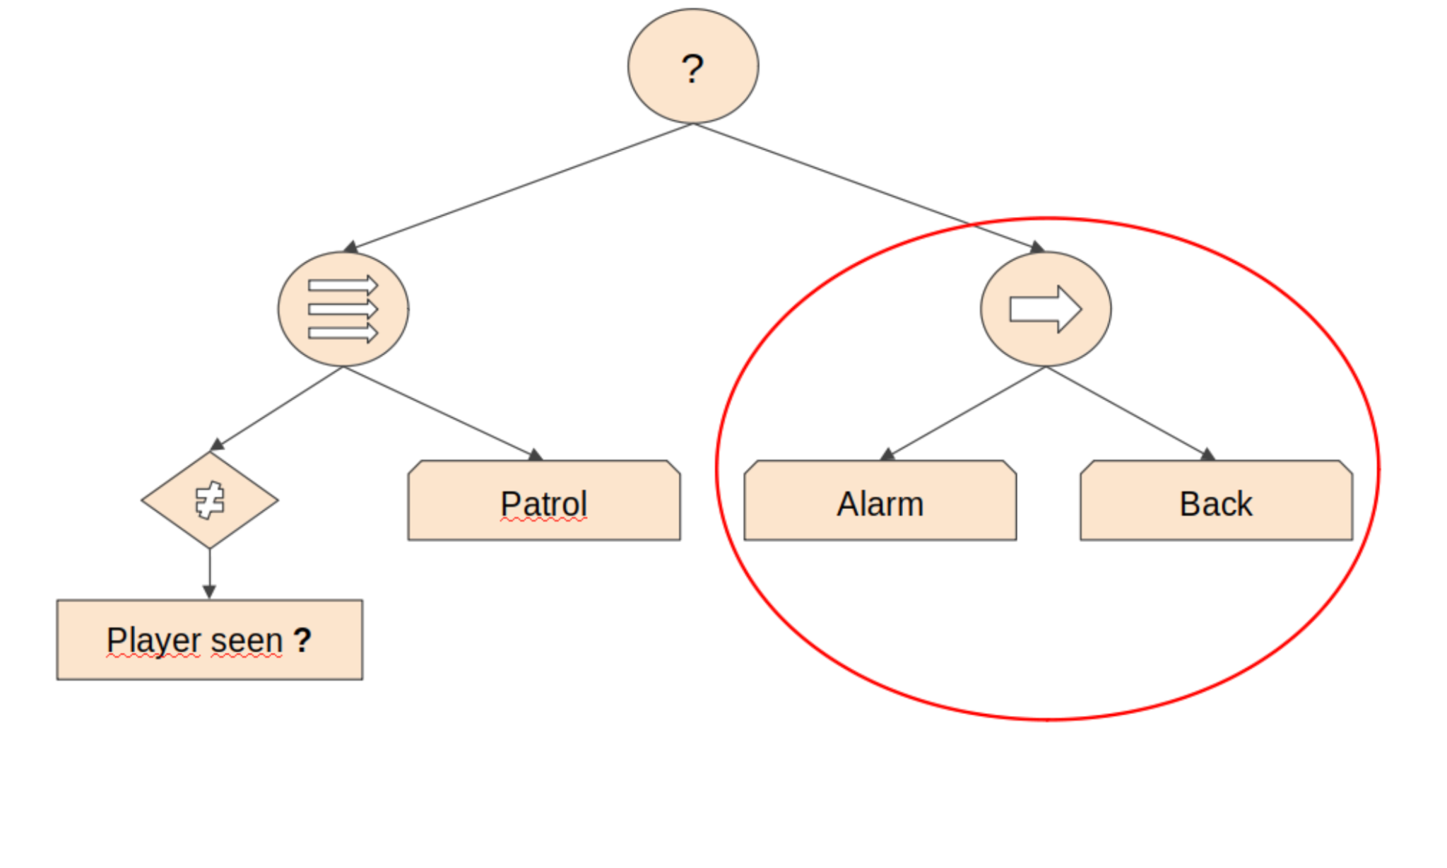
Nested Behaviour Trees

Slide 31
Overview
Introduction
Finite State Machines
Decision Trees
Behaviour Trees
Design
Behaviour Brincks
Planning Systems
References

Slide 32
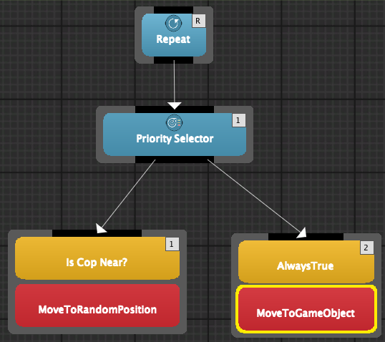
Behaviour Bricks
ToSteal behaviour tree:
Starting:
Handout
Editor:
Window Behavior Bricks - Editor
Robber:
Add Component Behavior executor component
BlackBoard/properties:
MoveToRandomPosition: Floor
MoveToGameObject: Treasure

Slide 33
using UnityEngine;
using Pada1.BBCore;
using Pada1.BBCore.Framework;
[Condition("MyConditions/Is Cop Near?")]
[Help("Checks whether Cop is near the Treasure.")]
public class IsCopNear : ConditionBase
{
public override bool Check()
{
GameObject cop = GameObject.Find("Cop");
GameObject treasure = GameObject.Find("Treasure");
return Vector3.Distance(cop.transform.position, treasure.transform.position) < 10f;
}
}

Slide 34
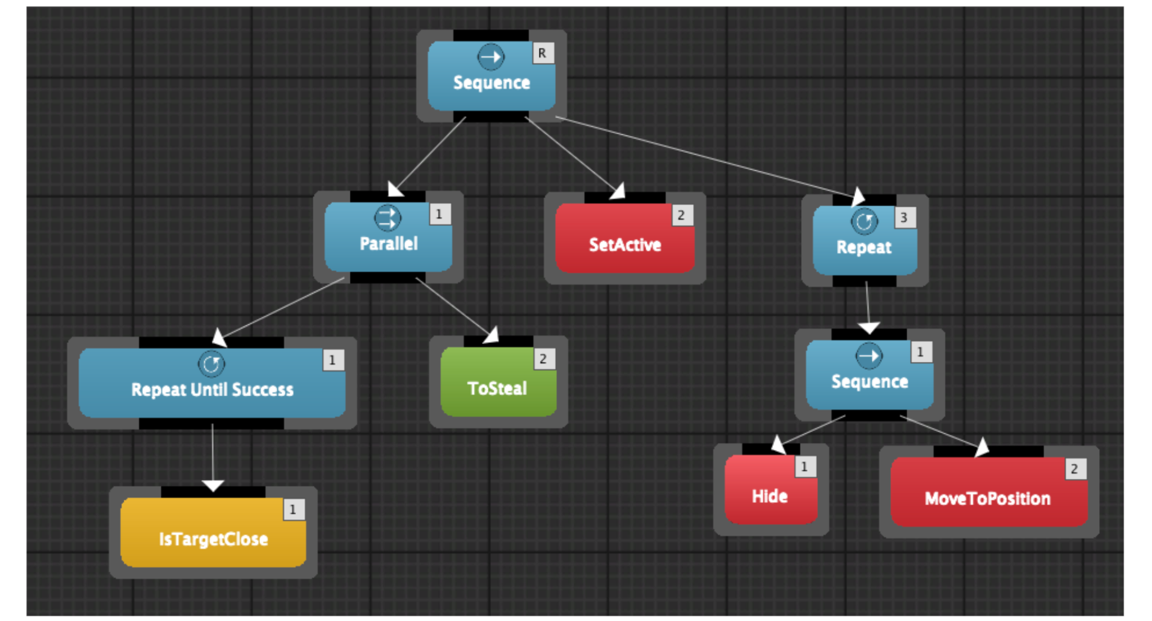
Behaviour Bricks II
ToSteal behaviour tree:

Slide 35
Behaviour Bricks III
Actions
ToSteal behaviour tree:
BlackBoard / properties:
IsTargetClose: Treasure, 2
ToSteal: Floor, Treasure
SetActive: false, Tresure
MoveToPosition: hide
using UnityEngine;
using Pada1.BBCore; // Code attributes
using Pada1.BBCore.Tasks; // TaskStatus
using Pada1.BBCore.Framework; // BasePrimitiveAction
[Action("MyActions/Hide")]
[Help("Get the Vector3 for hiding.")]
public class HideBB : BasePrimitiveAction
{
[InParam("game object")]
[Help("Game object to add the component, if no assigned the component is added to the game object of this behavior")]
public GameObject targetGameobject;
[OutParam("hide")]
[Help("Vector3 for higing.")]
public Vector3 hide;
public override TaskStatus OnUpdate()
{
Moves moves = targetGameobject.GetComponent<Moves>();
hide = moves.HideValue();
return TaskStatus.COMPLETED;
}
}

Slide 36
Behavior Bricks: Links of interest
Link: Store
Homework:
Watch this tutorials:
https://www.youtube.com/watch?v=CZvfuNfdc1M&t=533s
https://www.youtube.com/watch?v=qBCGSxlXOFY&ab_channel=Sephtis
Read the documentation:
https://bb.padaonegames.com/doku.php?id=quick%3Adesign

Slide 37
Overview
Introduction
Finite State Machines
Decision Trees
Behaviour Trees
Planning Systems
Goal Oriented Behaviour
Goal Oriented Action Planning
AI Planner
References

Slide 38
AI Paradigms
Reactive Al:
How to achieve goals → AI
Exs: FSM, DT, BT
Deliberative Al:
World behaviour + goals → AI
AI decides how to achieve its goals
Ex: Planners
Games using dynamic planning:
FEAR, Fallout 3, Total War, Deus Ex: Human Revolution, Shadow of Mordor, Tomb Raider

Slide 39
Goal Oriented Behaviour
Goals
each agent can have many active, and they could change
try to fulfill its goals or reduce its insistence (importance or priority as a number)
examples: eat, drink, kill enemy, regenerate health, etc.
Actions
atomic behaviours that fulfill a requirement
combination of positive and negative effects
Ex: "play game console" increases happiness but decreases energy
environment can generate or activate new available actions (smart objects)

Slide 40
People simulation example
Goal: Eat = 4
Goal: Sleep = 3
Action: Get-Raw-Food (Eat − 3)
Action: Get-Snack (Eat − 2)
Action: Sleep-In-Bed (Sleep − 4)
Action: Sleep-On-Sofa (Sleep − 2)
heuristic needed: most pressing goal, random...
+ fast, simple
− side effects, no timing information
Goal: Eat = 4
Goal: Bathroom = 3
Action: Drink-Soda (Eat − 2; Bathroom + 3)
Action: Visit-Bathroom (Bathroom − 4)

Slide 41
GOB: Discontent
It is an energy metric to minimize:
Sum of insistence values of all goals
Sum of square values: it accentuates high values
Example:
Goal: Eat = 4
Goal: Bathroom = 4
Action: Drink-Soda (Eat − 2; Bathroom + 2)
after: Eat = 2, Bathroom = 5: Discontentment = 29
Action: Visit-Bathroom (Bathroom − 4)
after: Eat = 4, Bathroom = 0: Discontentment = 16
Solution: Visit-Bathroom

Slide 42
GOB: Timing
Goal: Eat = 4 changing at + 4 per hour
Goal: Bathroom = 3 changing at + 2 per hour
Action: Eat-Snack (Eat − 2) 15 minutes
after: Eat = 2, Bathroom = 3.5: Discontentment = 16.25
Action: Eat-Main-Meal (Eat − 4) 1 hour
after: Eat = 0, Bathroom = 5: Discontentment = 25
Action: Visit-Bathroom (Bathroom − 4) 15 minutes
after: Eat = 5, Bathroom = 0: Discontentment = 25
Solution: Eat-Snack

Slide 43
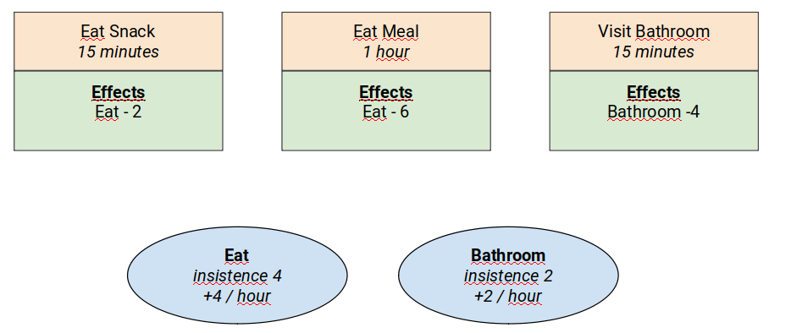
GOB Design
Goal: Eat = 4 changing at + 4 per hour
Goal: Bathroom = 2 changing at + 2 per hour
Action: Eat-Snack (Eat − 2) 15 minutes
Action: Eat-Main-Meal (Eat − 6) 1 hour
Action: Visit-Bathroom (Bathroom − 4) 15 minutes

Slide 44
Overview
Introduction
Finite State Machines
Decision Trees
Behaviour Trees
Planning Systems
Goal Oriented Behaviour
Goal Oriented Action Planning
AI Planner
References

Slide 45
The need for planning
Example:
Mage character
5 charges in its wand
need for healing
an ogre approaching him aggressively
plan
GOB is limited in its prediction, the situation needs to go some steps ahead!
Goal: Heal = 4
Goal: Kill-Ogre = 3
Action: Fireball (Kill-Ogre − 2) 3 charges
Action: Lesser-Healing (Heal − 2) 2 charges
Action: Greater-Healing (Heal − 4) 3 charges
Best combination: Lesser-Healing + Fireball
GOB solution: Greate-Healing

Slide 46
Goal Oriented Action Planning
Chaining actions
preconditions for chaining actions
states for satisfying preconditions
search algorithm for selecting "best" branches (each goal is the root of a tree)
Searching
BFS increasing the number of actions and goals it becomes quickly inefficient
A* perhaps distance heuristic cannot be formulated
Dijkstra: usual solution

Slide 47
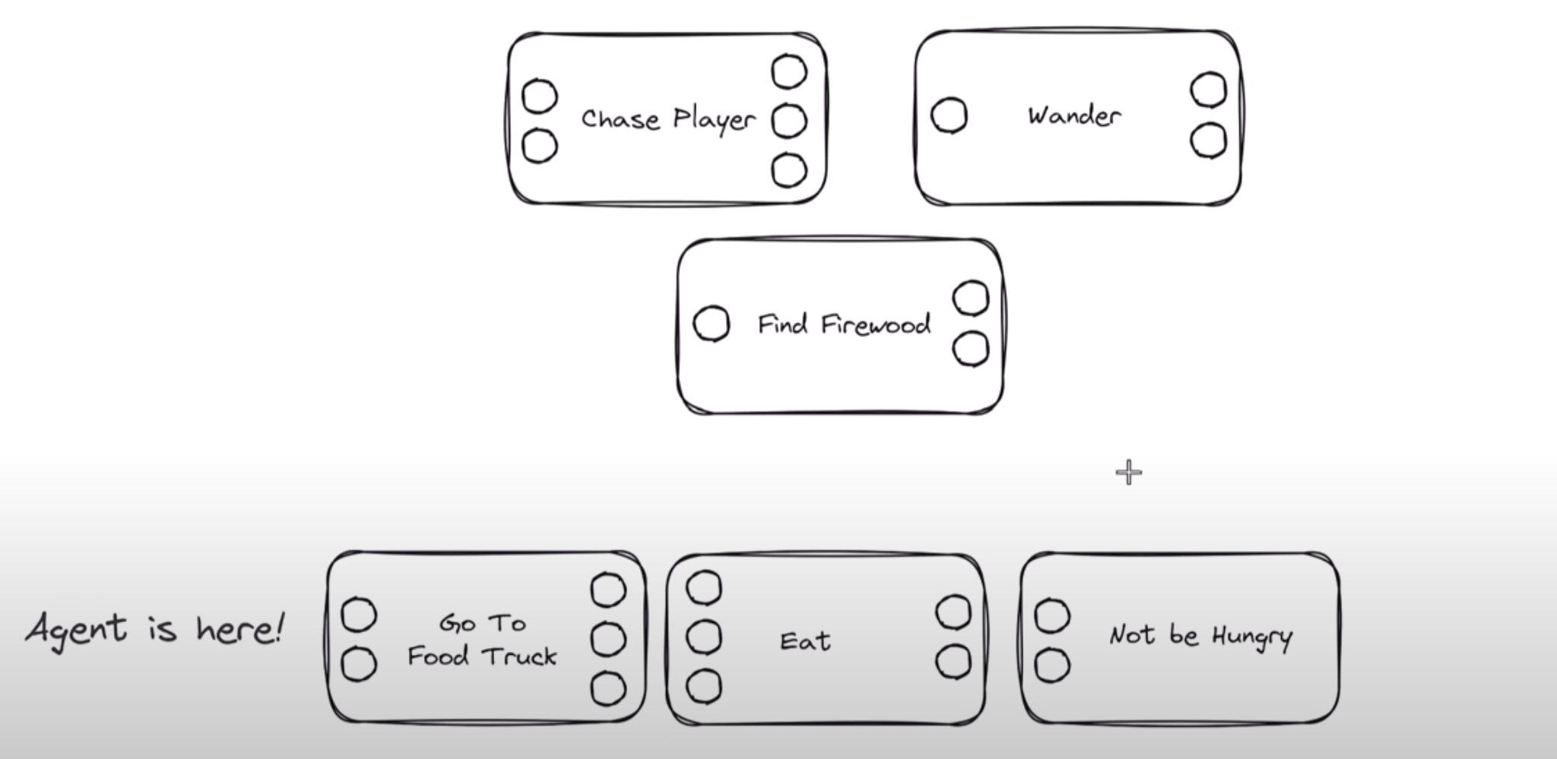
Goal Oriented Action Planning

Slide 48
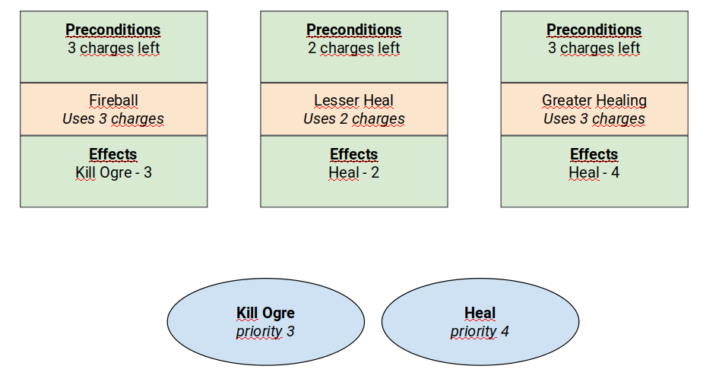
GOAP Design
Goal: Heal = 4
Goal: Kill-Ogre = 3
Action: Fireball (Kill-Ogre 2) 3 charges
Action: Lesser-Healing (Heal - 2) 2 charges
Action: Greater-Healing (Heal 4) 3 charges
Google Canvas Template

Slide 49
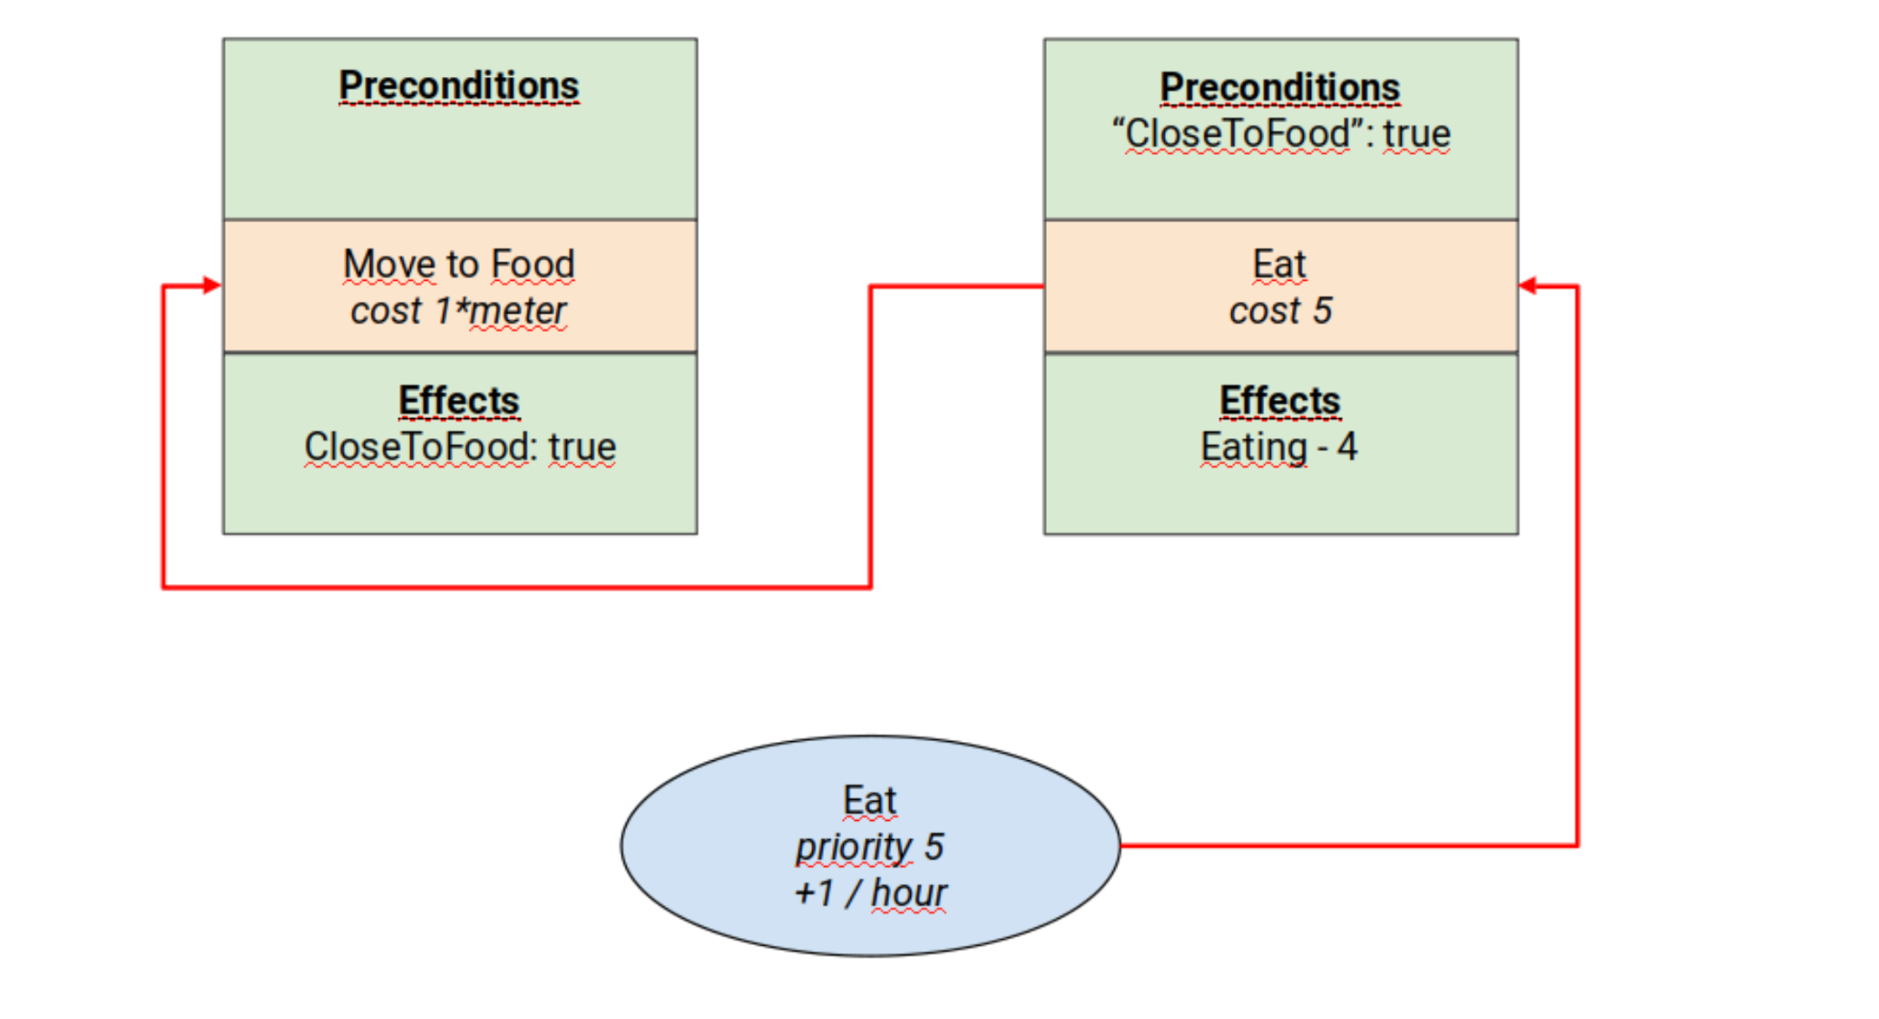
GOAP: Time

Slide 50
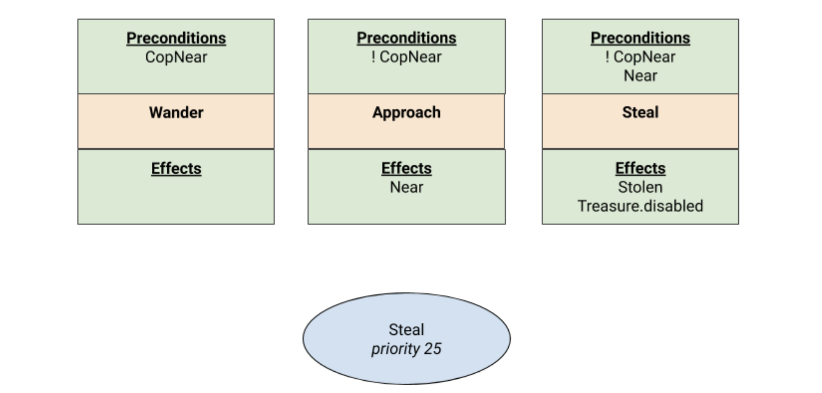
Robber behaviour
First approach

Slide 51
Some tutorials to learn GOAP
https://www.youtube.com/watch?v=T_sBYgP7_2k
https://www.youtube.com/watch?v=tdBWk2OVCWc&list=PLi-ukGVOag_1DCBZG1rRg_SpiyI6I5Qcr

Slide 52
Overview
Introduction
Finite State Machines
Decision Trees
Behaviour Trees
Planning Systems
Goal Oriented Behaviour
Goal Oriented Action Planning
AI Planner
References

Slide 53
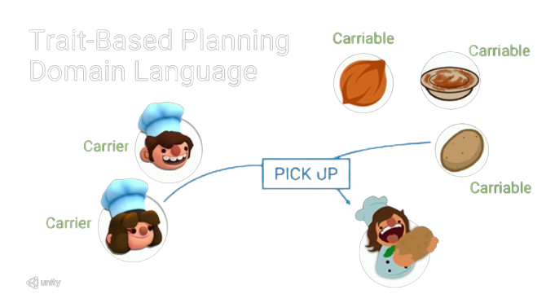
AI Planner
The AI Planner package can generate optimal plans for use in agent AI
Reference
it contains a plan visualizer

Slide 54
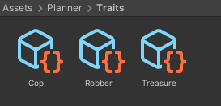
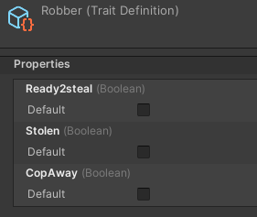
Robber: Traits
Traits
Create - Semantic - Trait Definition
fundamental data (game state)
quality of objects (components)
contains attributes
Robber
Treasure
Cop
Robber: CopAway (false), Ready2steal (false), Stolen (false)
Building the traits
Menu - Semantic - Traits - Build

Slide 55
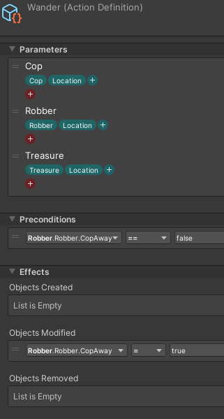
Robber: Actions I
Actions
Create - AI - Planner - Action - Definition
planner potential decisions
executes nothing
Properties:
name, parameters,
preconditions, effects,
cost/reward
Robber
Wander
parameters: cop, robber, treasure
precondition: CopAway == false
effects: CopAway = true

Slide 56
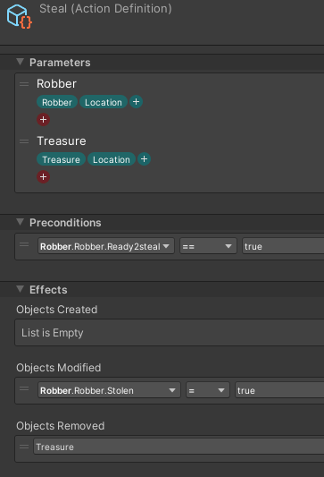
Robber: Actions Il
Robber
Approach
parameters: cop, robber, treasure
precondition: CopAway == true, Ready2steal false
effect: Ready2steal = true
Steal
parameters: robber, treasure
precondition: Ready2steal == true
effect: Stolen = true,
treasure removed

Slide 57
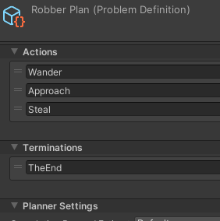
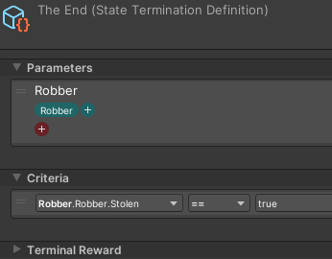
Robber : Plan
Plan
create - AI - Planner - Problem Definition
Termination criteria
create - AI - Planner - Termination Definition
Building the Plan
Menu - AI - Planner - Build

Slide 58
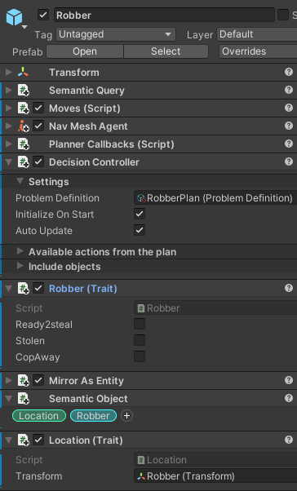
Robber: Configuring the Scene
Add Component - Semantic Object
to the GameObjects
Add Component -DecisionController
to the AI agent GameObject
Add the plan definition
Add the world objects
with traits
Create and link the callbacks...

Slide 59
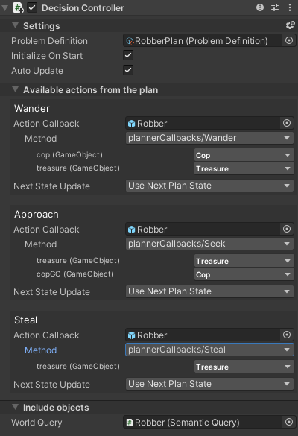
Robber: Action Callbacks
Action Definitions components are not applied to the scene
It is the Action Callbacks goal
Coroutine is the choice for
actions that execute over multiple frames
Robber
C# view*

Slide 60
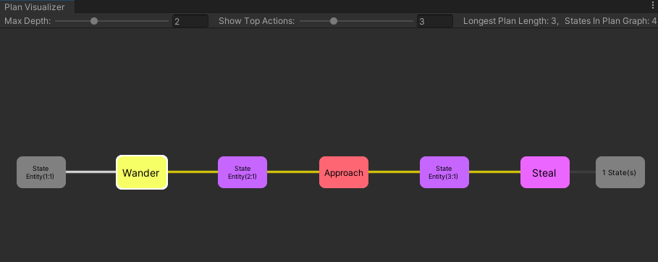
AI Planner:Debugging
Window - AI -Plan Visualizer
Source & documentation

Slide 61
Al Planner: dynamic planning
Example:
Non linear behaviour of Robber
Traits in scripts
Approach: Next State Update
C# code
view* /cs

Slide 62
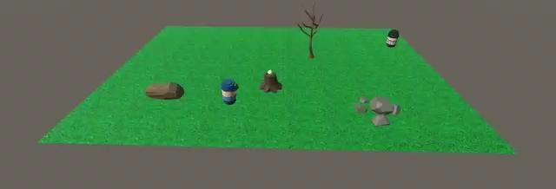
The result
Robber video

Slide 63
Overview
Introduction
Finite State Machines
Decision Trees
Behaviour Trees
Planning Systems
References

Slide 64
References
Ian Millington. AI for Games (3rd edition). CRC Press, 2019.
Penny de Byl. Artificial Intelligence for Beginners. Unity Course.
Chris Simpson. Behavior trees for AI: How they work. Gamasutra, 2014.
Unity Technologies. AI Planner. 2020.
Damian Isla. Handling Complexity in the Halo 2 AI. GDC, 2005.
Ricard Pillosu. Previous year slides of the AI course, 2019.

